Slide 1
SS ZG653 (RL 10.2): Software Architecture Blackboard Architecture
Instructor: Prof. Santonu Sarkar

Slide 2
Context and Problem
A set of heterogeneous specialized modules which dynamically change their strategies as a response to unpredictable events
Non-deterministic strategies
Problem
When there is no deterministic solutions to process raw data, and it is required to interchange algorithms processing some intermediate computation
Solutions to partial problems require different representation
No predetermined strategy is present to solve a problem (in functional decomposition sequence of activations are more hard-coded)
Dealing with uncertain knowledge

Slide 3
Forces
A complete search of the solution space is not possible
Different algorithms to be used for partial solutions
One algorithm uses results of another algorithm
Input, intermediate data, output can have different representation
No strict sequence between algorithms, one can run them concurrently if required

Slide 4
Examples
Speech recognition (HEARSAY project 1980)
Vehicle identification and tracking
Robot control (navigation, environment learning, reasoning, destination route planning)
Modern machine learning algorithms for complex task (Jeopardy challenge)
Adobe OCR text recognition
Modern compilers tend to be more Blackboard oriented

Slide 5
Blackboard Pattern
Two kinds of components
Central data structure — blackboard
Components operating on the blackboard
System control is entirely driven by the blackboard state

Slide 6
Components of Blackboard
The blackboard is the shared data structure where solutions are built
􏰝 The control plan encapsulates information necessary to run the system
It is accessed and up dated by control knowledge sources
DomainKS are concerned with the solving of domain specific problems
Control KS adapt the current control plan to the current situation
The control component selects, configures and executes knowledge sources

Slide 7
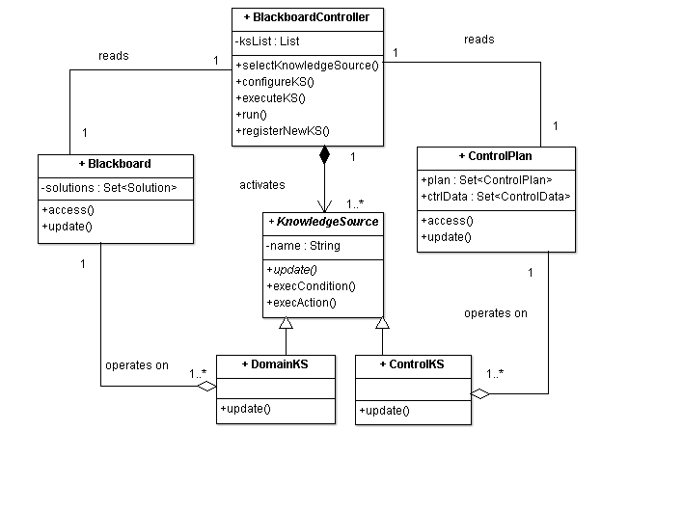
Solution Structure
Runs in a loop
Monitors change in blackboard
Activates next KS
Selection strategy may depend on ControlData
Highly specialized modules
Each is different
Has a set of triggering conditions
Executable code that retrieves data from the blackboard and updates blackboard
Don’t interact with each other
Updates control Data
Such as:
progress estimation,
computation cost to execute a KS
Control plan
Shared datastore containing partial solutions

Slide 8
Automated Robo Navigation
Robot’􏰏s high level goal is to visit a set of places as so on as possible
The successive sub􏰂goals are
to decide on a sequence of places to visit􏰃
to compute the best route􏰃 and
to navigate with a constraint of rapidity􏰄

Slide 9
Benefits
Benefits
Liabilities
Experimentation- try with different strategies,
Support for modifiability- each KS is strictly decoupled
Reuse of KS
Fault-tolerance even when the data is noisy
Difficulty in testing
No good solution guaranteed
Computational overhead in rejecting wrong solutions
High development effort
Concurrent access to blackboard must be synchronized, parallelization is difficult

Slide 10
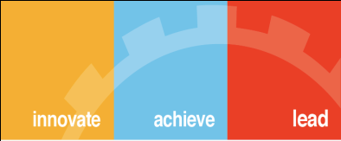
Thank You

